Slide 1
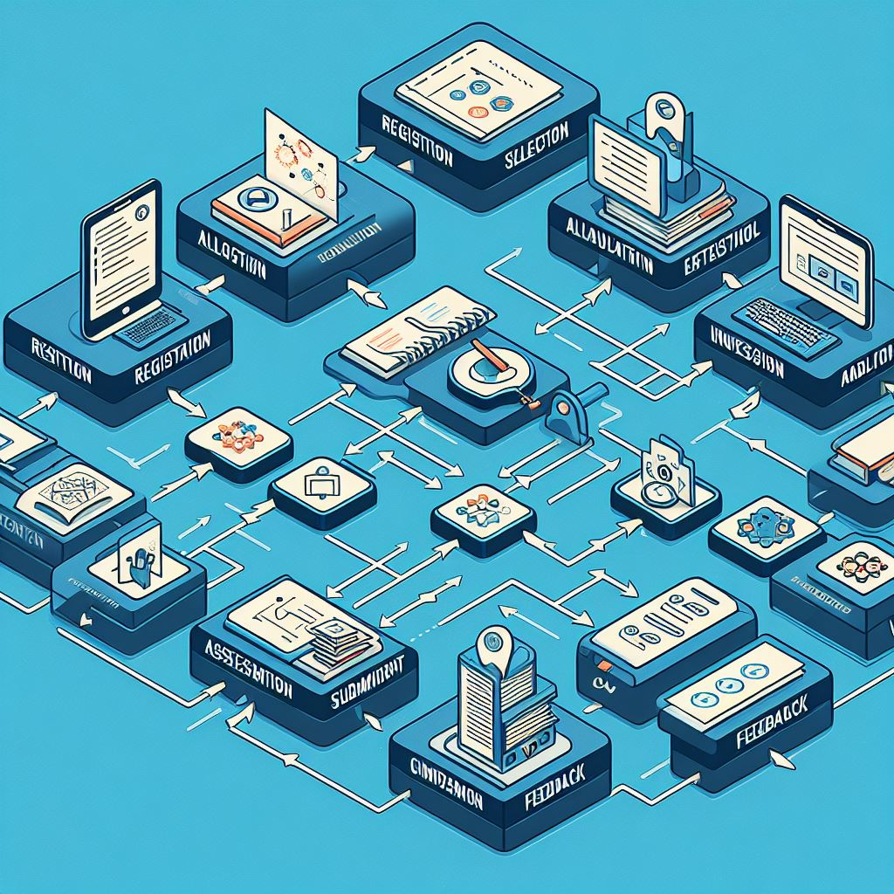
Project Module Management System
JUN_WE_34

Slide 2
Team Members
Name | IT Number | Functions
Gamlath W.A.V.K | IT21211928 | Student Functions Examiner Function
K.P.V Pathirana | IT21244766 | Project Coordinator Functions
A.M.B.S Bandara | IT21229398 | Project Member Functions
Hasanka G.S | IT21233876 | Supervisors and Co-Supervisors Functions

Slide 3
Introduction
A comprehensive system to manage and assess year-long project modules for IT, SE, IS, CS, DS, and CSNE students.
Teams of four students collaborate, ideally from the same specialization.
Four presentations (Proposal, Progress 1, Progress 2, and Final) evaluated by three examiners.
Reports (topic assessment, project charter, status documents, log-book, proposal, and final thesis) assessed by supervisors and co-supervisors.
Streamlines mark recording, presentation scheduling, report management, and project oversight.

Slide 4
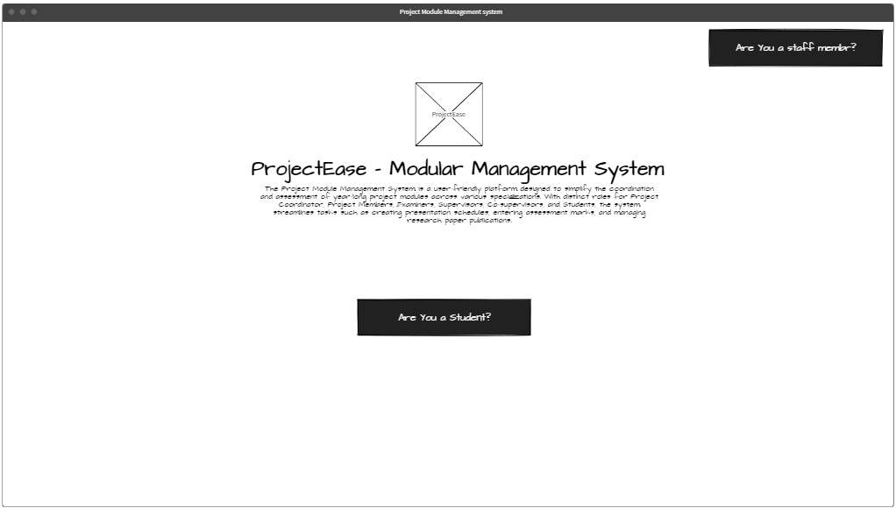
Home Page
IT21211928

Slide 5
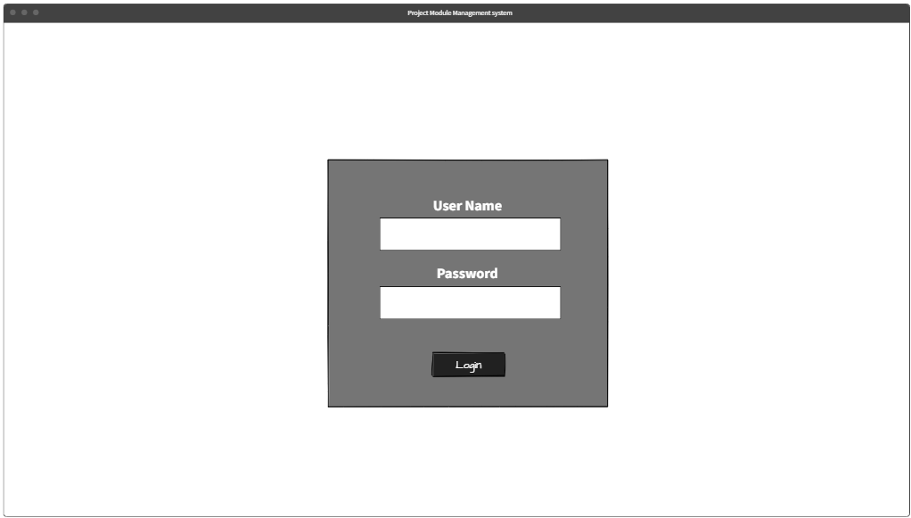
Login Portal
IT21211928

Slide 6
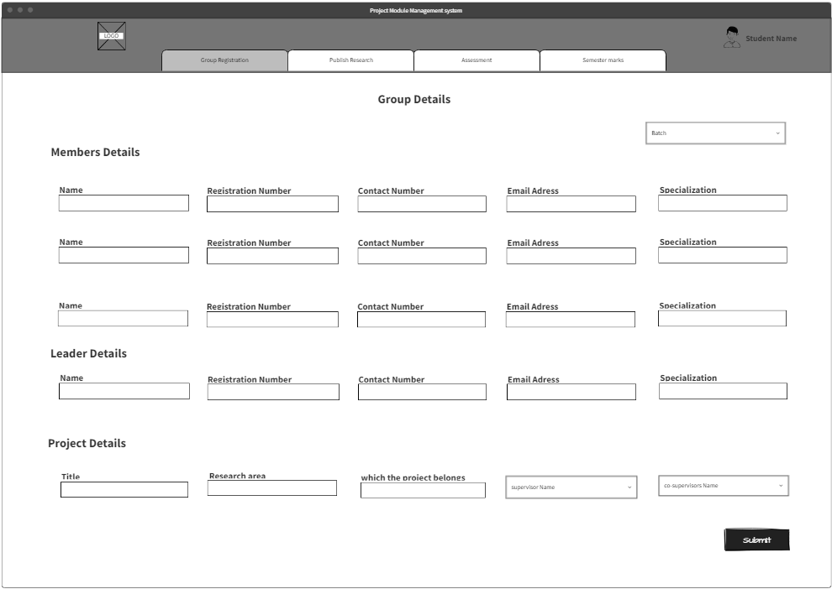
Research Group Registration
IT21211928

Slide 7
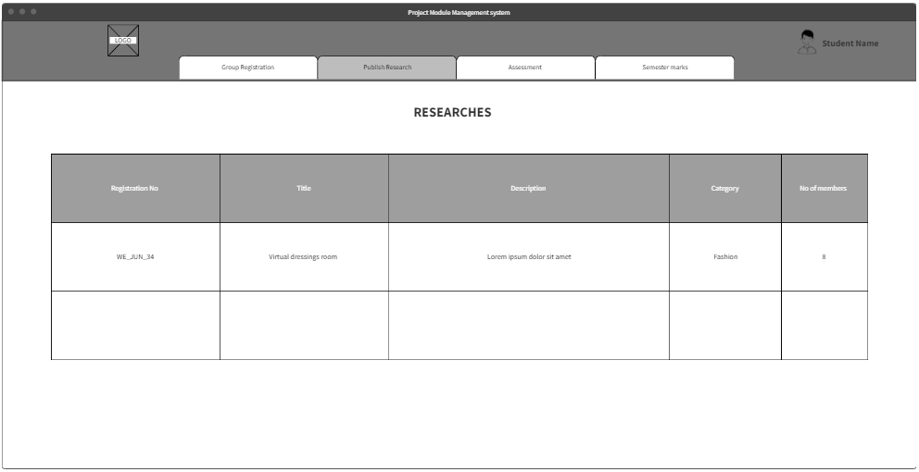
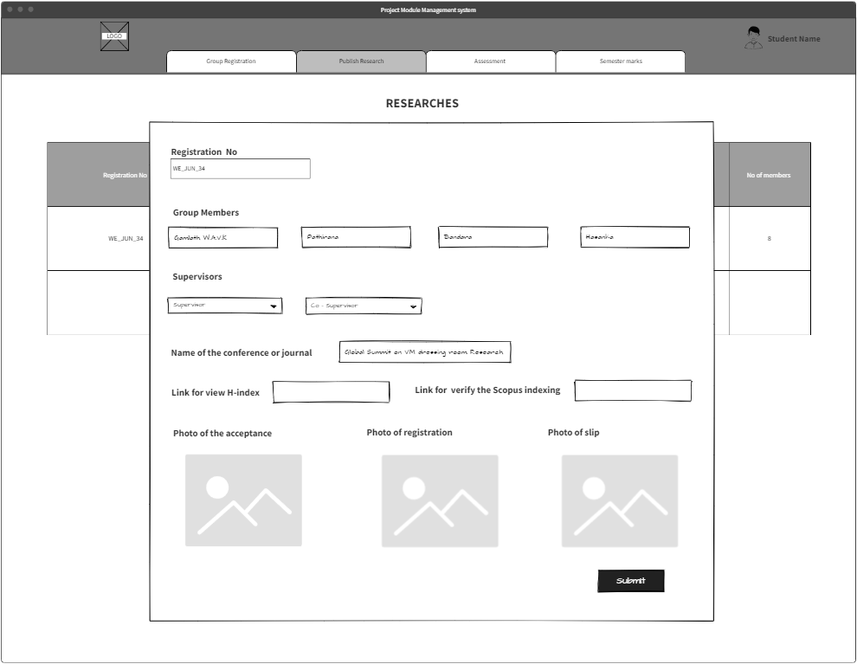
Research Paper Publication
IT21211928

Slide 8
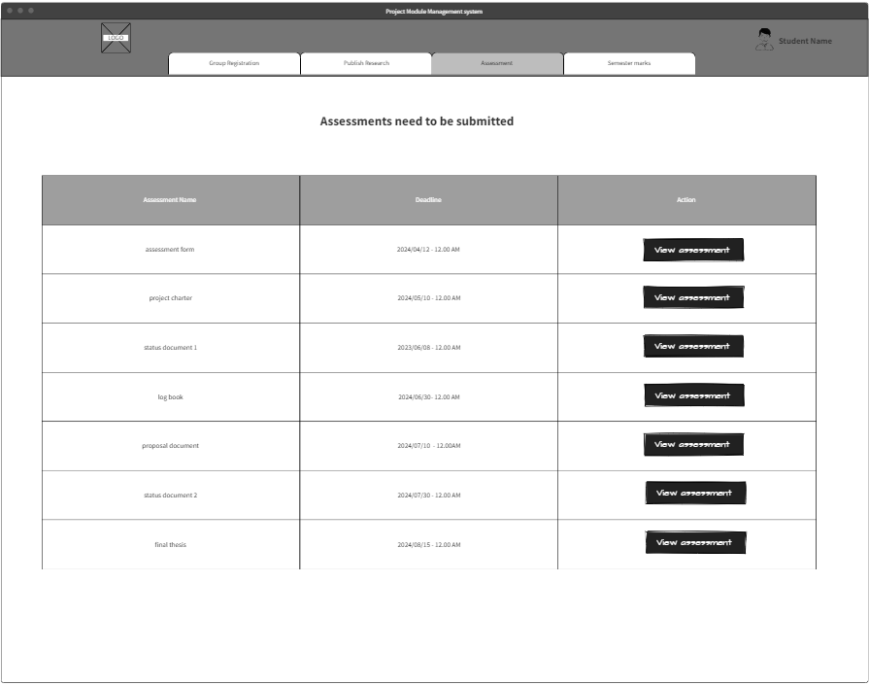
View Available Assessment
IT21211928

Slide 9
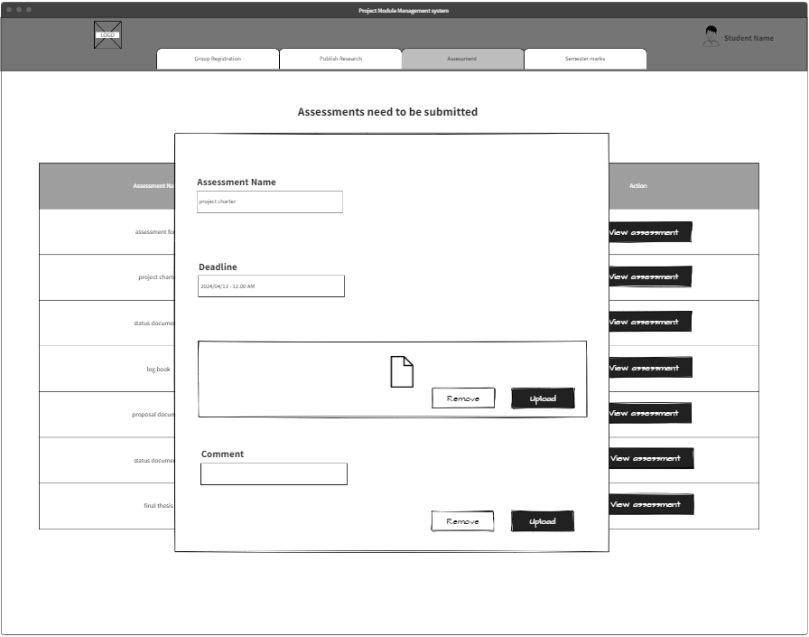
Submit Available Assessment
IT21211928

Slide 10
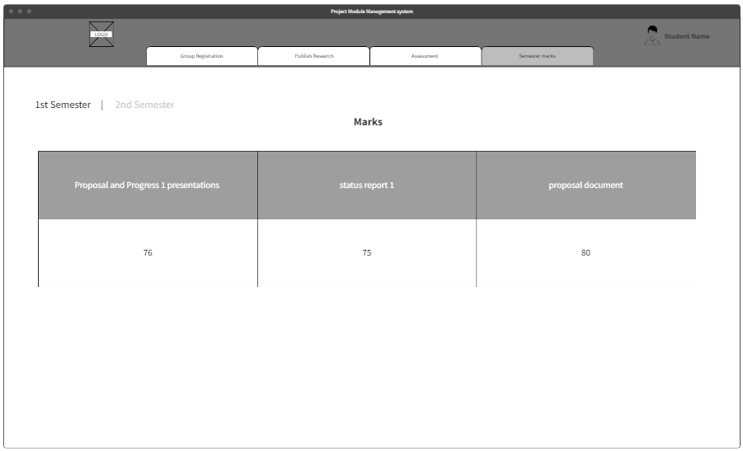
View 1st Semester Marks
IT21211928

Slide 11
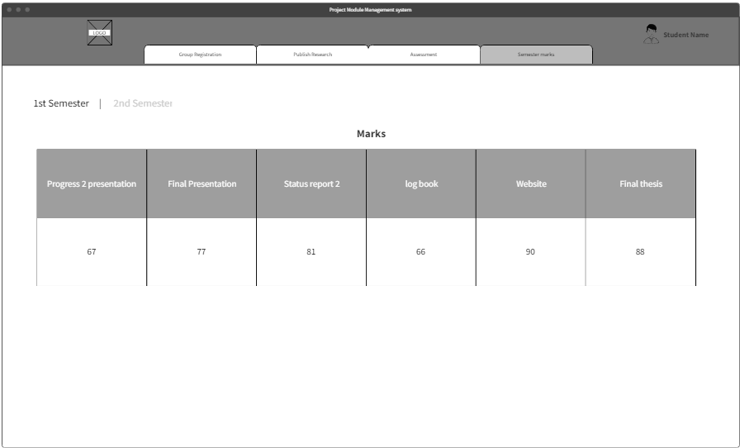
View 2nd Semester Marks
IT21211928

Slide 12
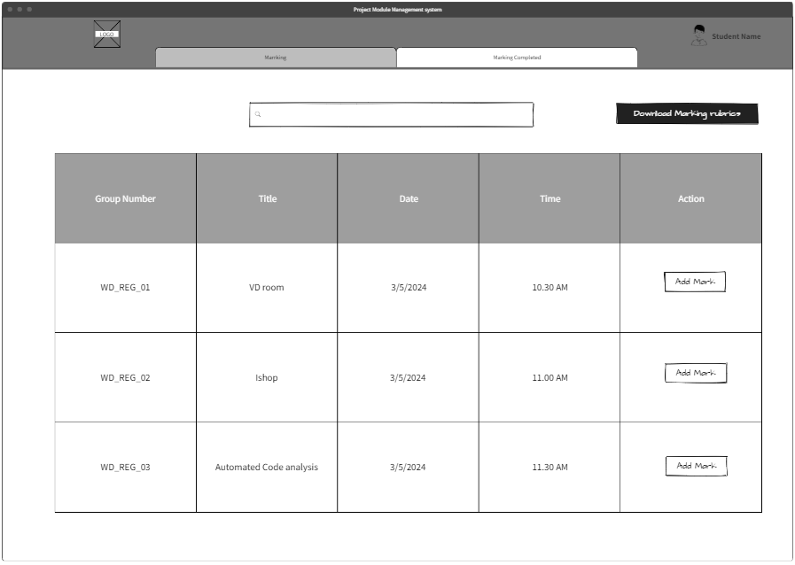
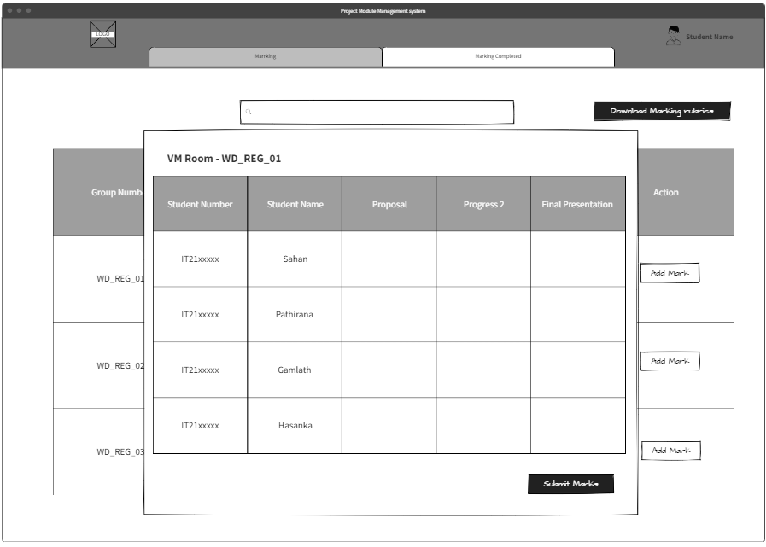
Examiner Add Marks
IT21211928

Slide 13
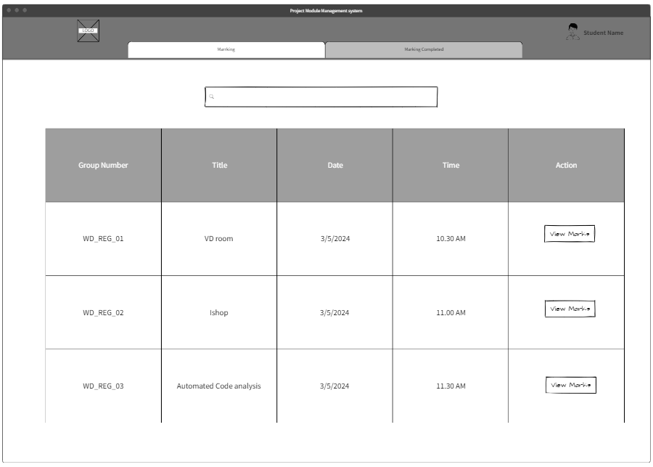
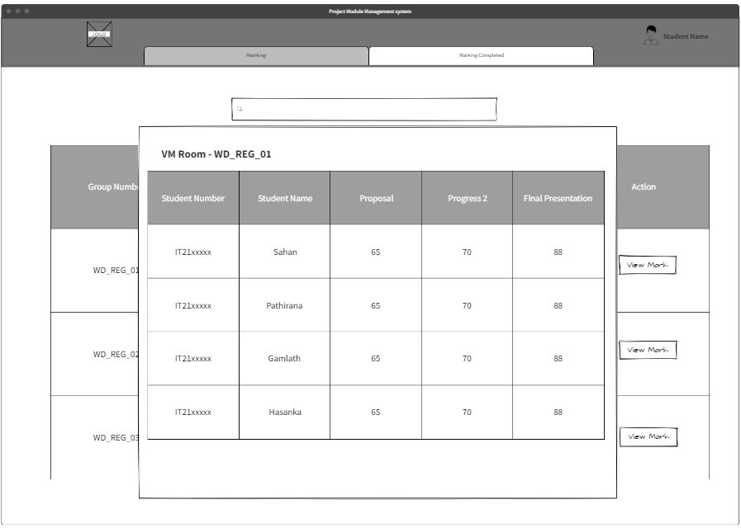
Examiner View Added Marks
to the System
IT21211928

Slide 14
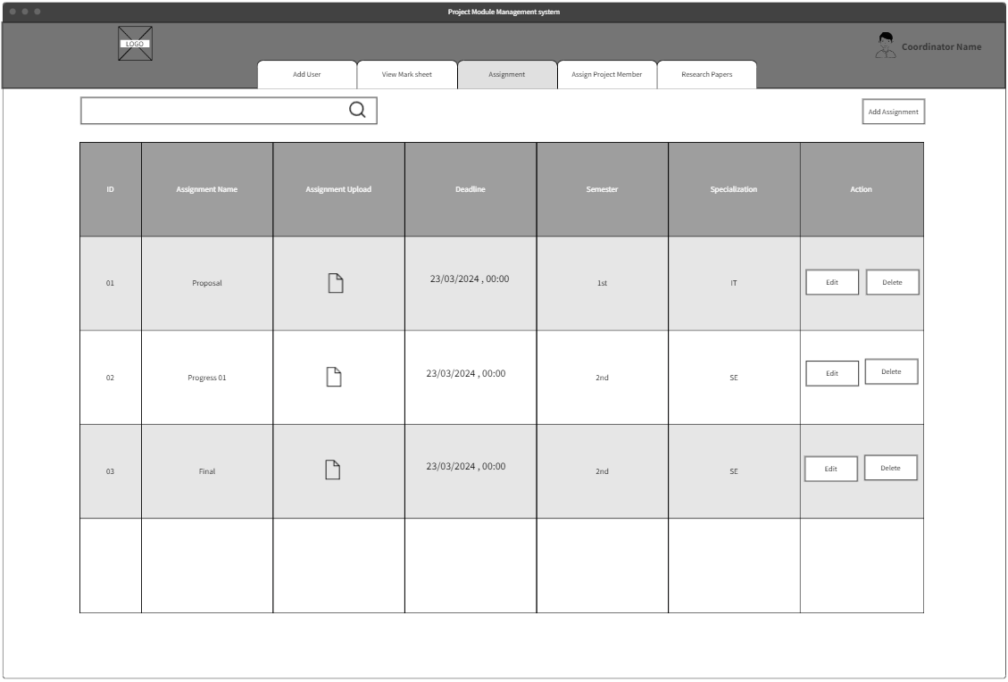
Add New Assignment to the System &
View Existing Assessments
IT21244766

Slide 15
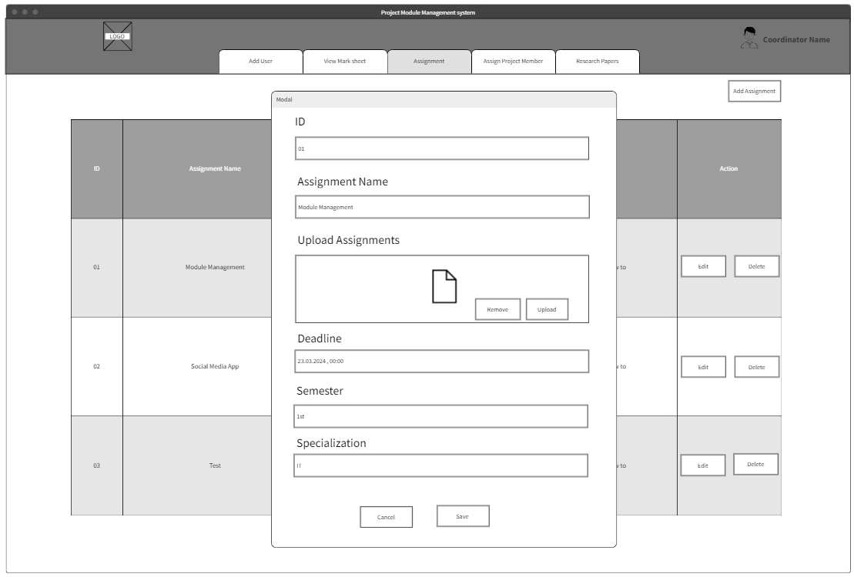
Add New Assignment
IT21244766

Slide 16
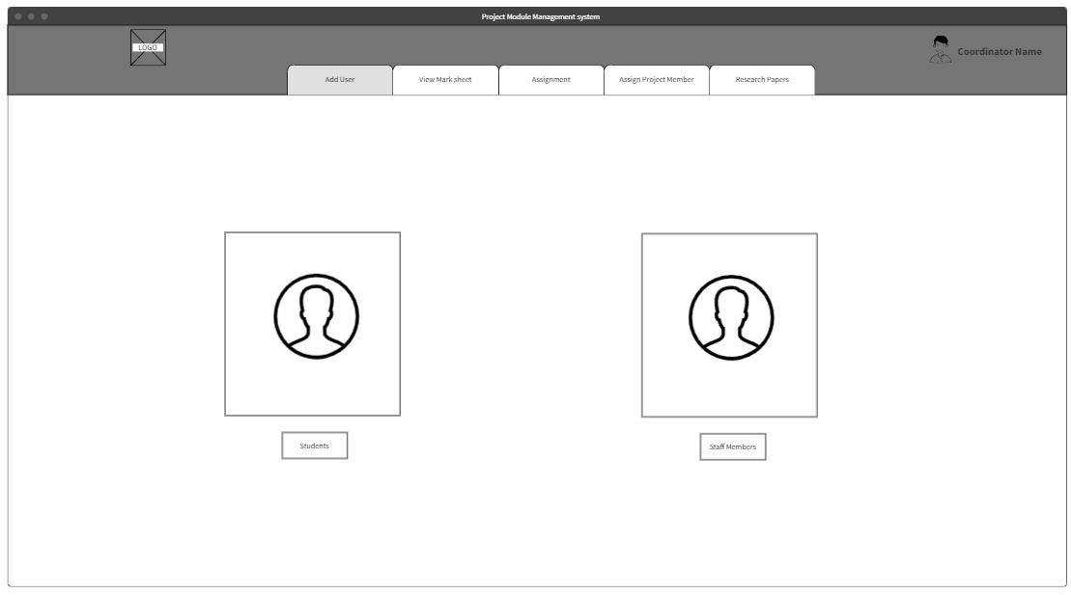
Add New Users to the System
IT21244766

Slide 17
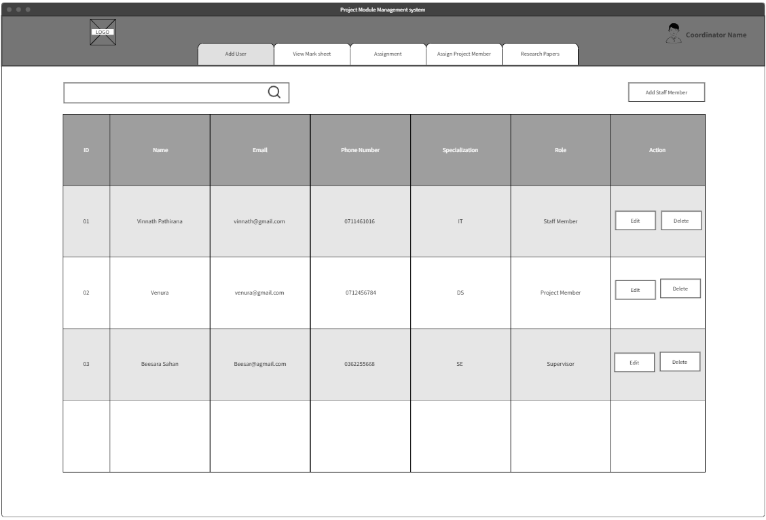
Add Staff Members to the system.
View all staff member details and their role.
Edit the member details and delete existing members.
IT21244766

Slide 18
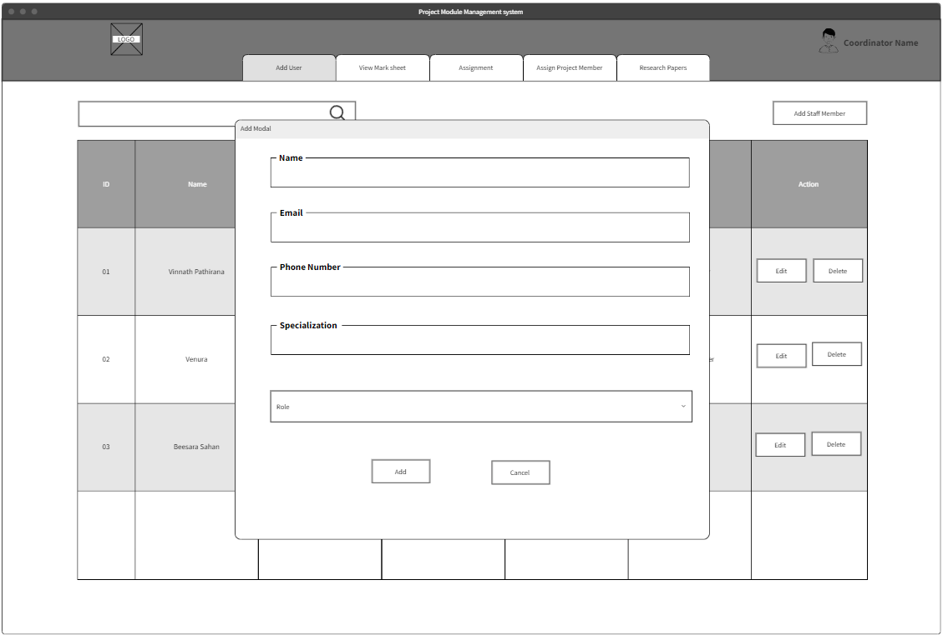
Add New Staff Member Model
IT21244766

Slide 19
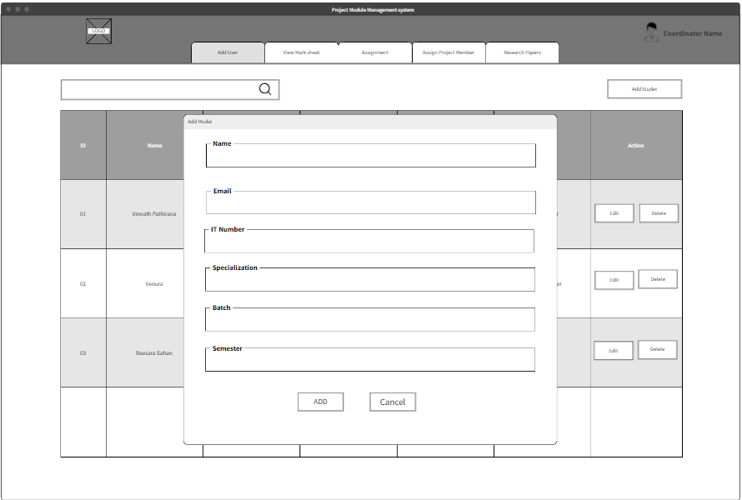
Add New Student to the System
IT21244766

Slide 20
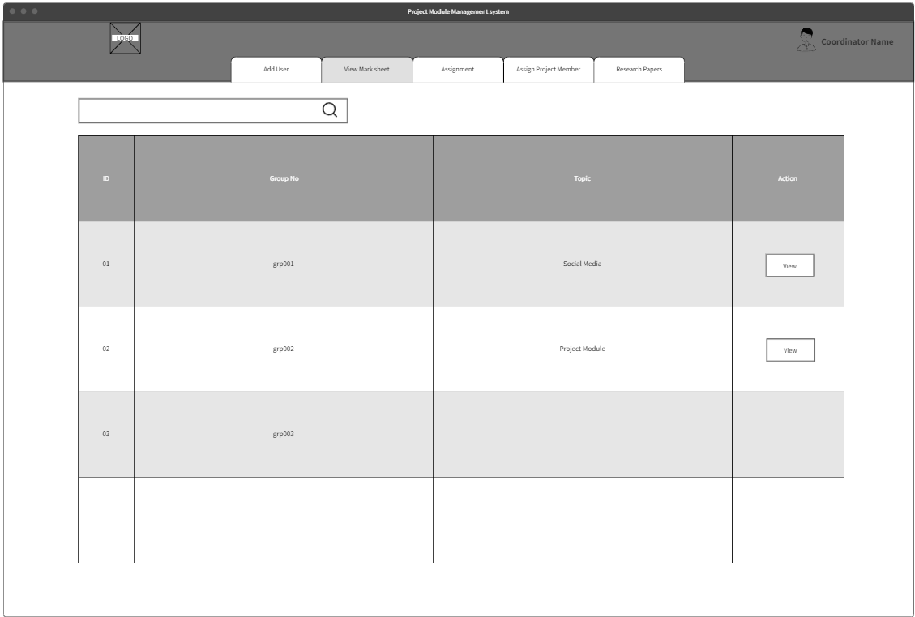
View the Mark of each Group
IT21244766

Slide 21
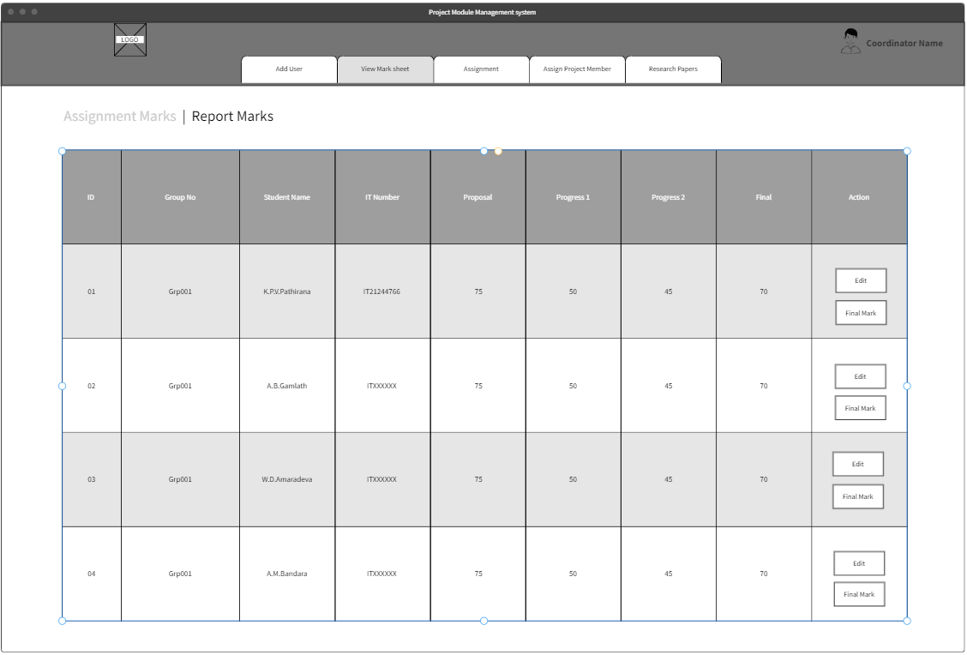
View each Student’s Assignment Marks &
Edit the Marks
IT21244766

Slide 22
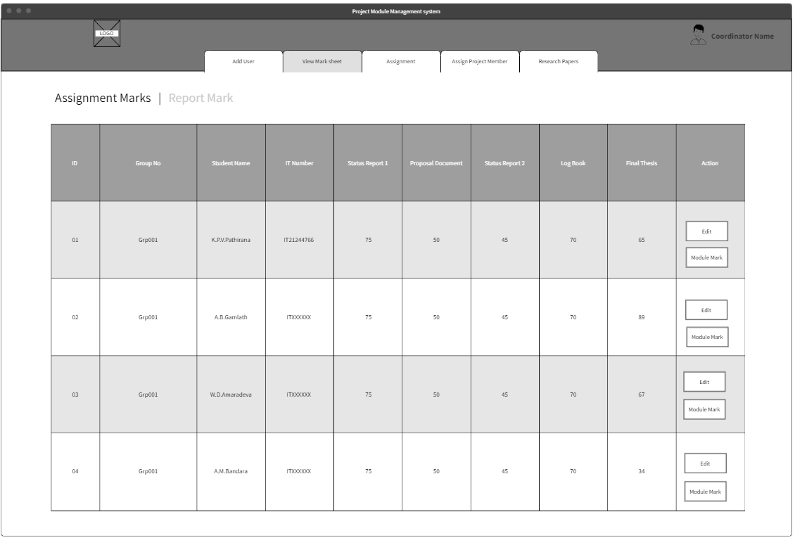
View Each Student Report Marks &
Edit the Mark
IT21244766

Slide 23
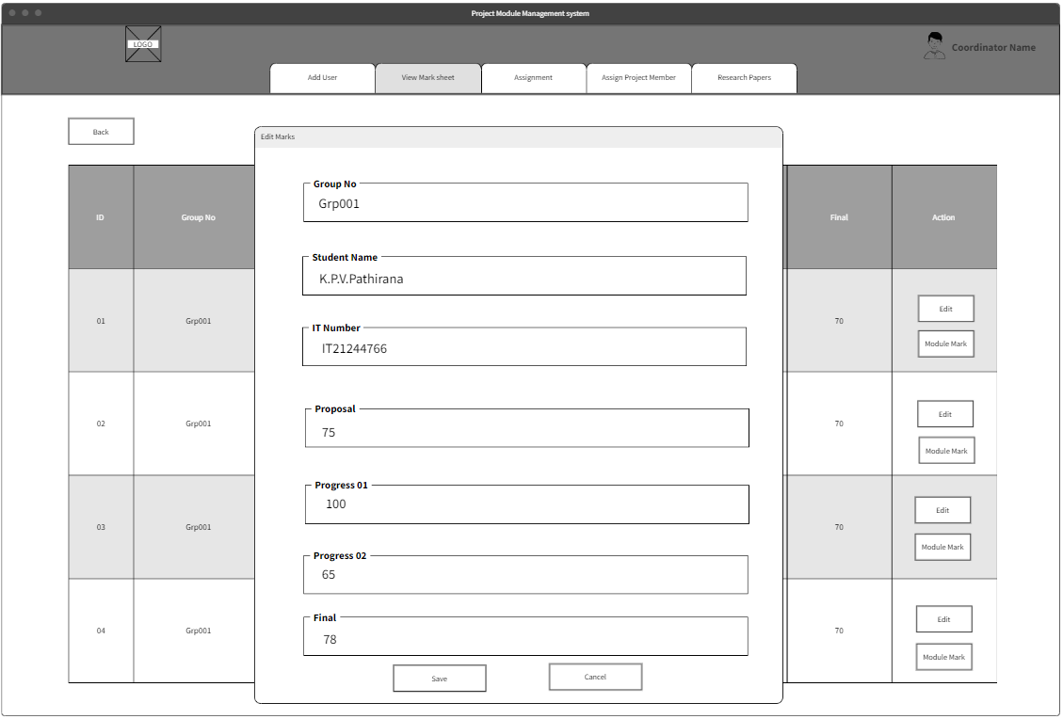
Edit the Marks Model
IT21244766

Slide 24
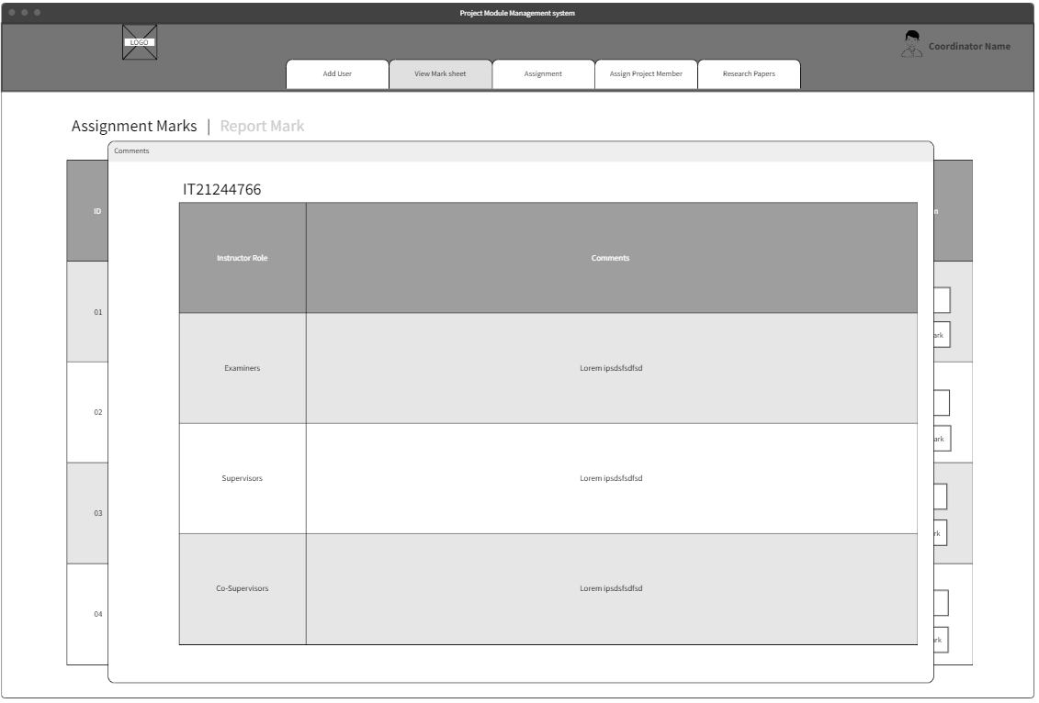
By Clicking Marks, the coordinator can view comments
IT21244766

Slide 25
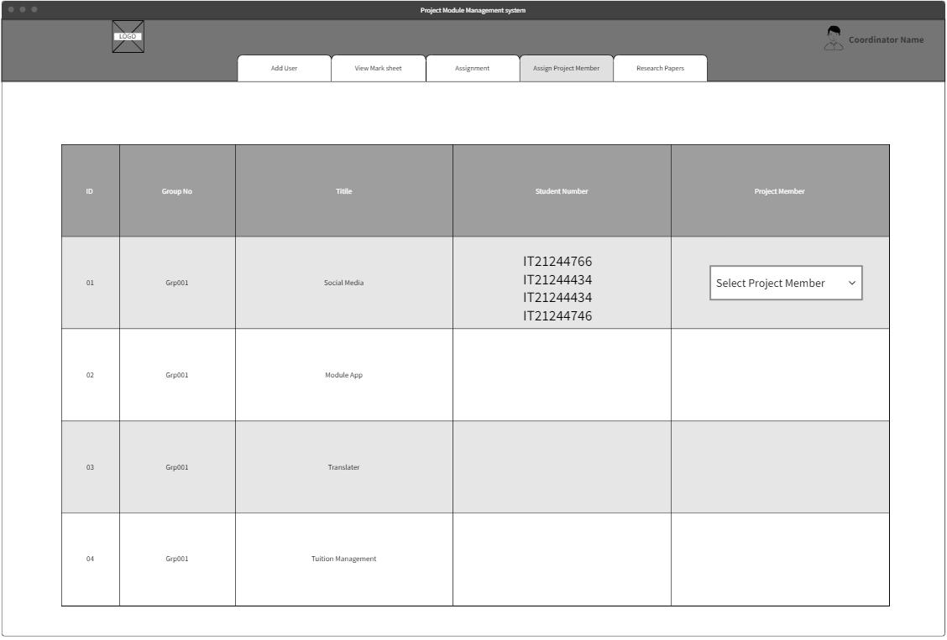
Assign a project member for each group
IT21244766

Slide 26
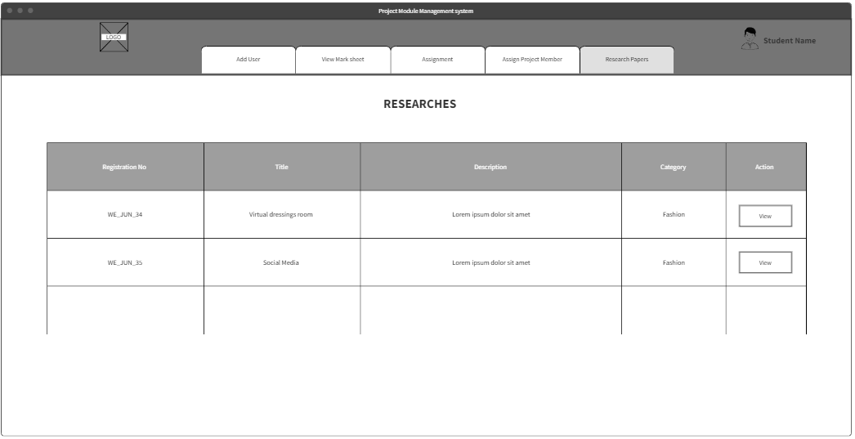
View the research papers which are uploaded to the system
IT21244766

Slide 27
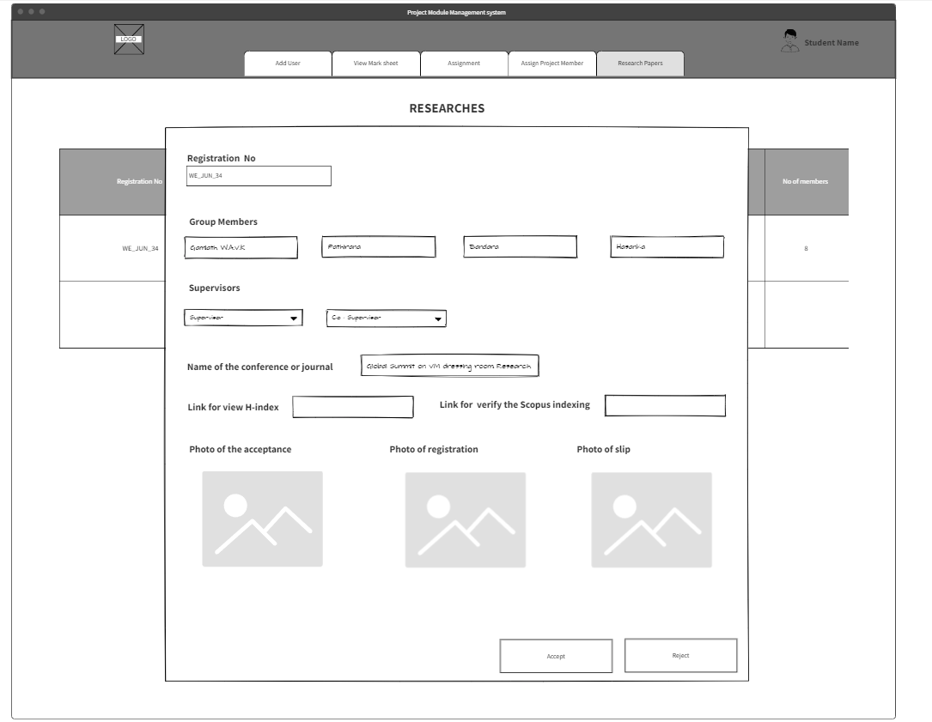
Accept or reject the research paper
IT21244766

Slide 28
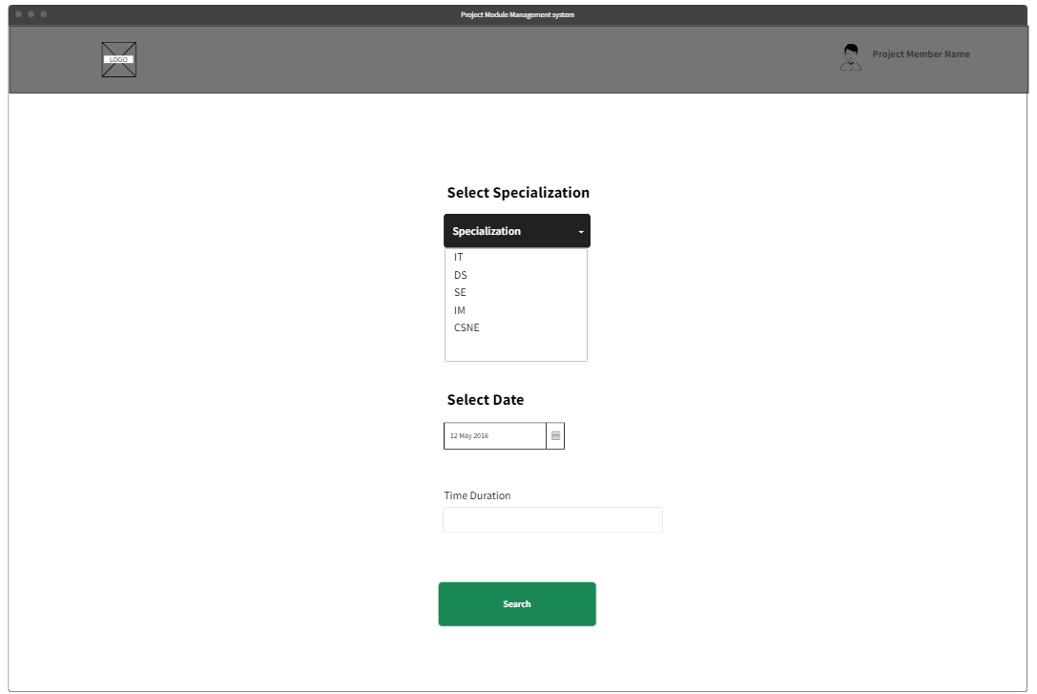
Select the specialized &
give date and time duration
IT21229398

Slide 29
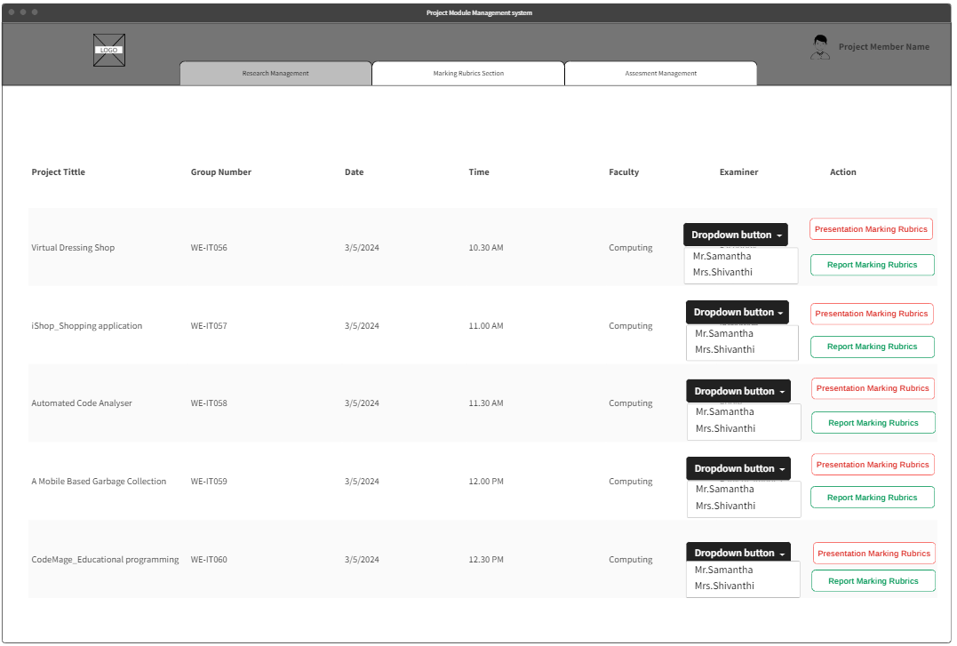
Assign an examiner to each project
IT21229398

Slide 30
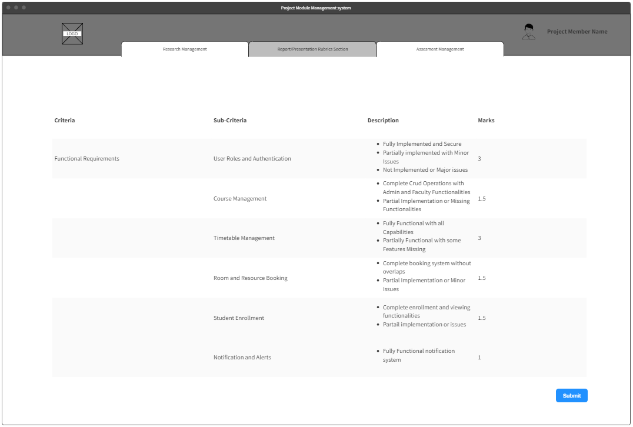
Report and Presentation Marking Rubrics adding section
IT21229398

Slide 31
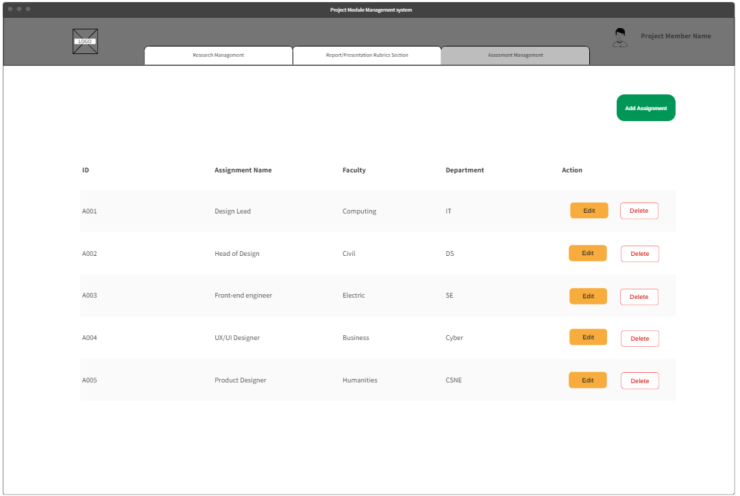
Assignment Management Area
IT21229398

Slide 32
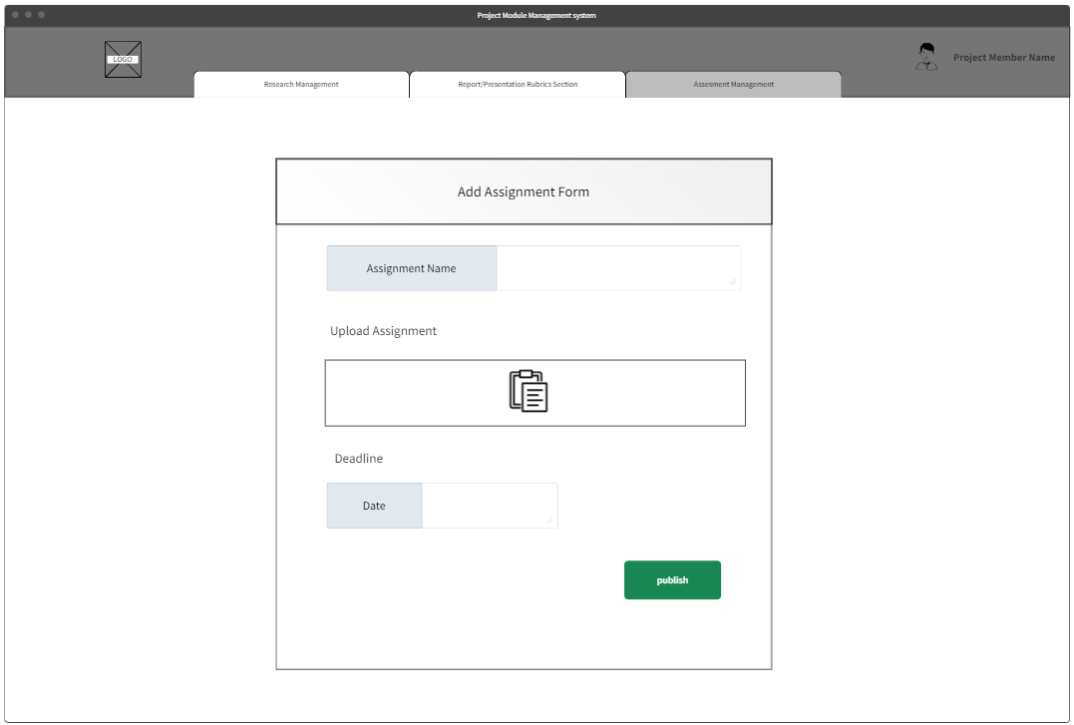
Add Assignment Form
IT21229398

Slide 33
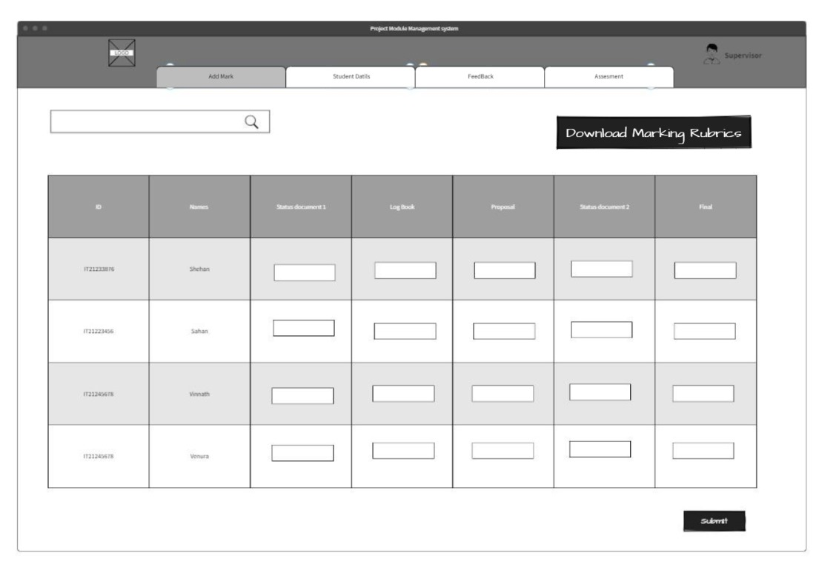
Download Report &
Give the Mark
IT21233876

Slide 34
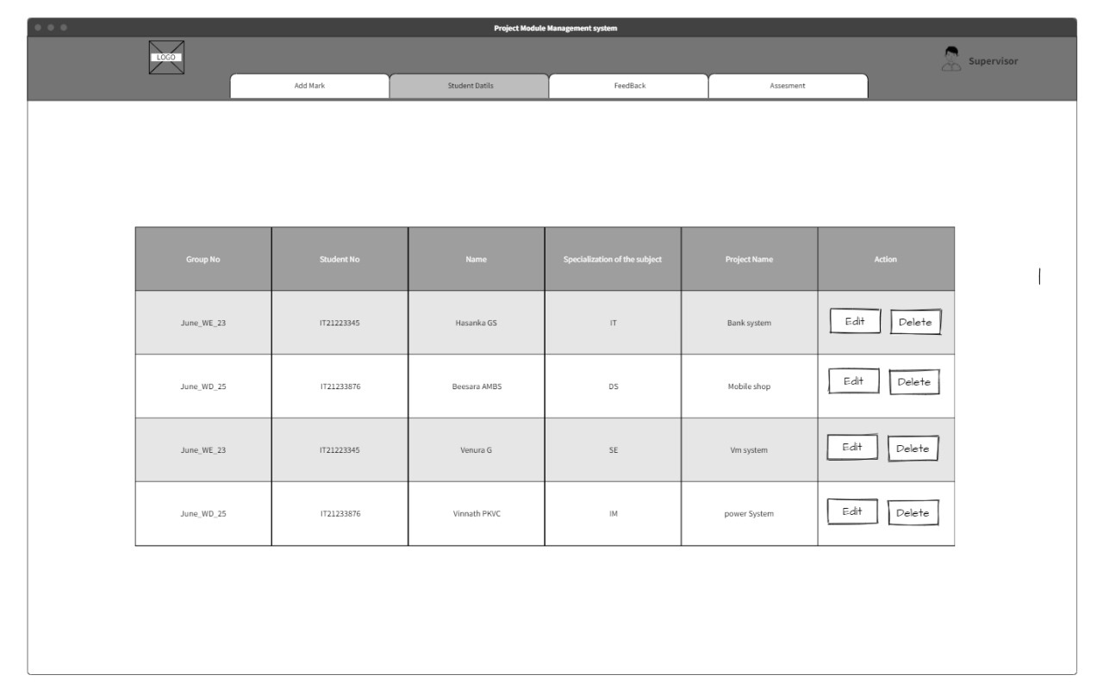

Search Student Details
IT21233876

Slide 35
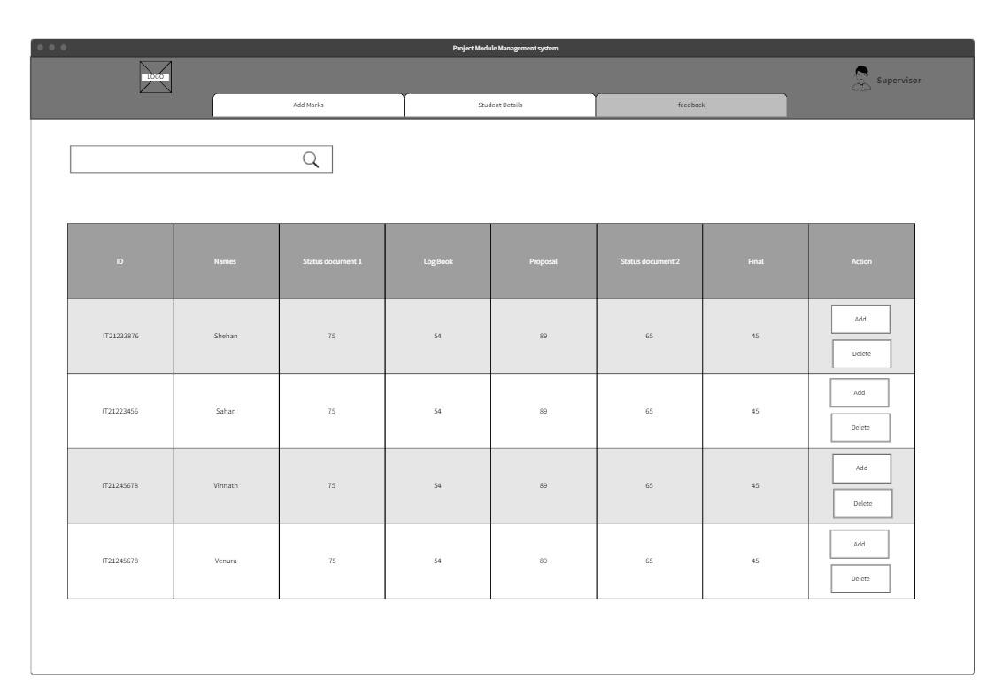
View Marks
IT21233876

Slide 36
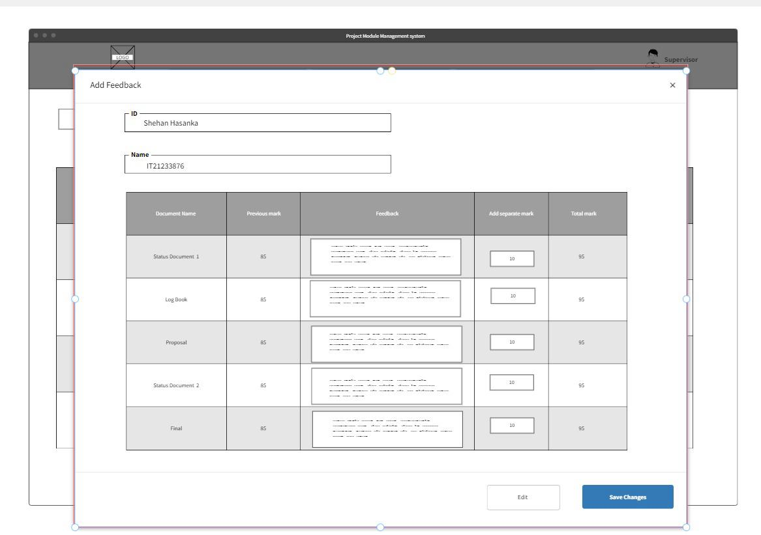
Add Feedback for Rubrics
IT21233876

Slide 37
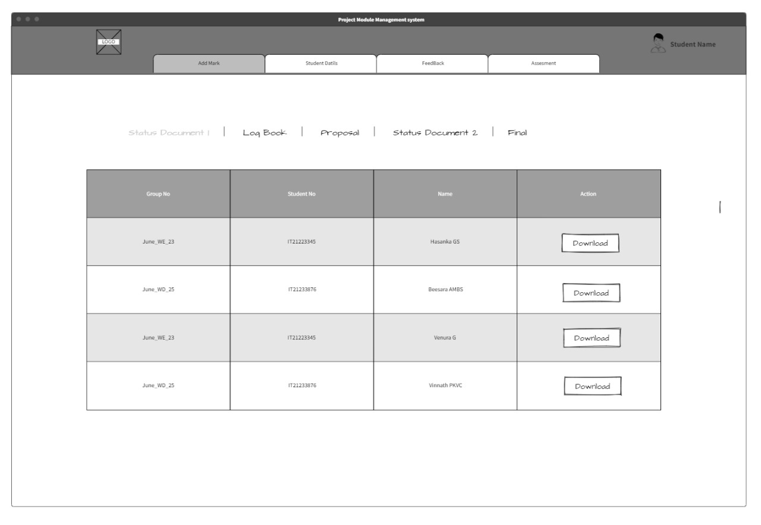
Download Student Document
IT21233876

Slide 38
Thank You

